Slide 1
React fundamentals
www.devbridge.com
Sourcery Academy

Slide 2
Agenda
React intro
JSX
Components
Props
Class components
State
Lifecycles
Events
Coding examples
Advanced subjects

Slide 3
What is React.js?
A JavaScript Library for Building User Interfaces
"View" in the MVC
Notes:
React is the "View" in the application, a fast one. It also provides different ways to organize your templates and gets you think in components. In a React application, you should break down your site, page or feature into smaller pieces of components. It means that your site will be built by the combination of different components. These components are also built on the top of other components and so on. When a problem becomes challenging, you can break it down into smaller ones and solve it there. You can also reuse it somewhere else later. Think of it like the bricks of Lego. We will discuss component-driven development more deeply in this article later.

Slide 4
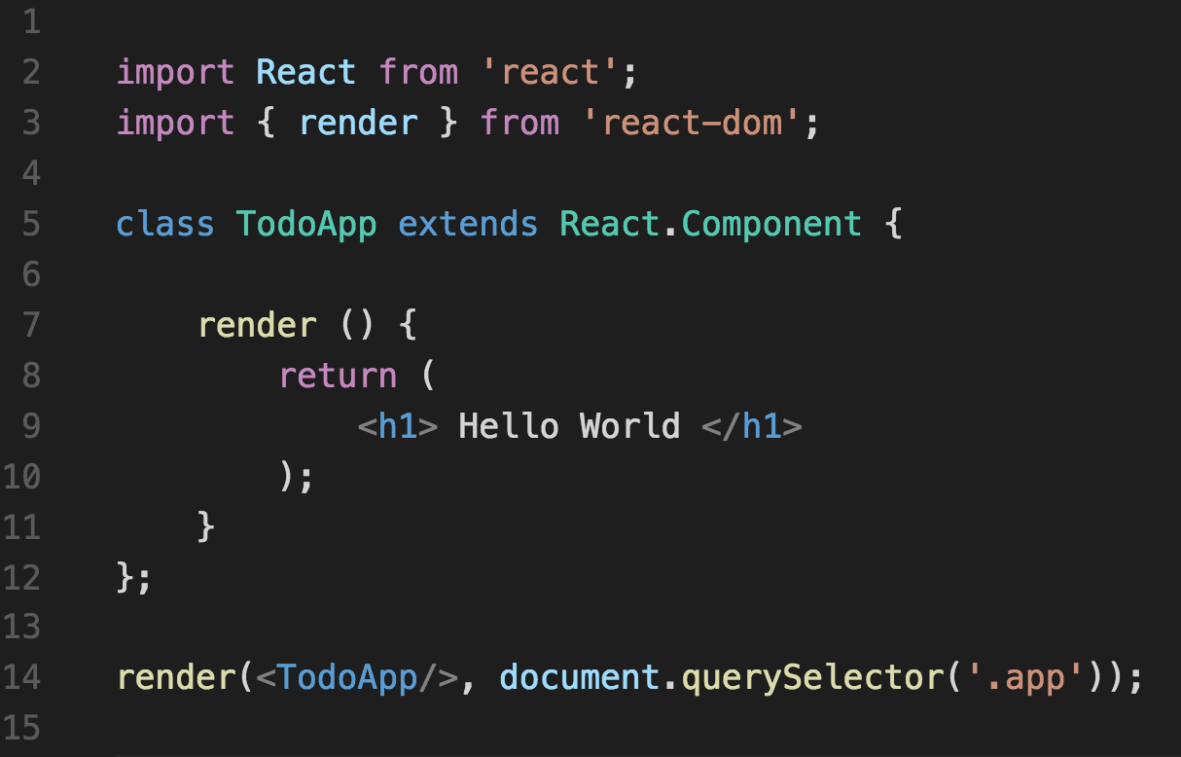
Simple example
Notes:
Talk about how react interacts with DOM
ES6 syntax

Slide 5
Why React.js?
It’s a concept rather than a library
Component-based approach to developing UI
Architecture beyond HTML (ex: react native)

Slide 6
Why React.js?
Virtual (Shadow) DOM
One way direction flow
Immutability

Slide 7
JSX
Extends JavaScript syntax
Allows to use HTML tags for defining components
HTML syntax is processed into JavaScript calls of the React library
Notes:
JSX pavyzdys:
http://babeljs.io/repl/#?babili=false&evaluate=true&lineWrap=false&presets=latest%2Creact%2Cstage-2&targets=&browsers=&builtIns=false&experimental=false&loose=false&spec=false&code=%3Cdiv%3E%3C%2Fdiv%3E&playground=true

Slide 8
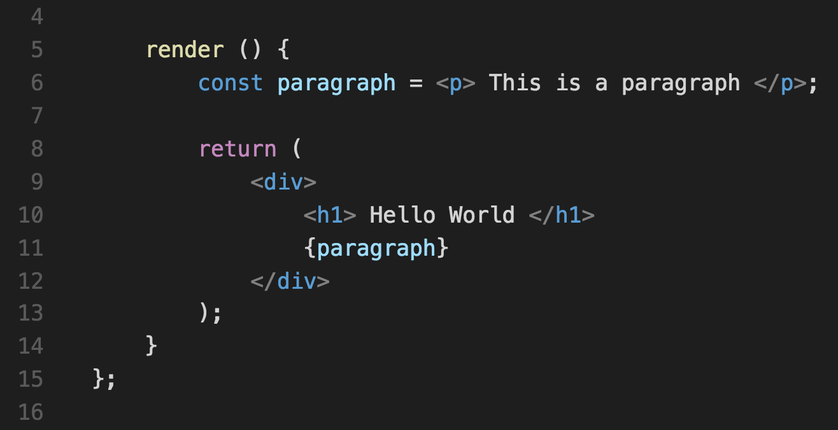
JSX example

Slide 9
Components
Components let you split the UI into independent, reusable pieces, and think about each piece in isolation. Aka “Lego” approach

Slide 10
Component props
Conceptually, components are like JavaScript functions. They accept arbitrary inputs (called "props") and return React elements describing what should appear on the screen.

Slide 11
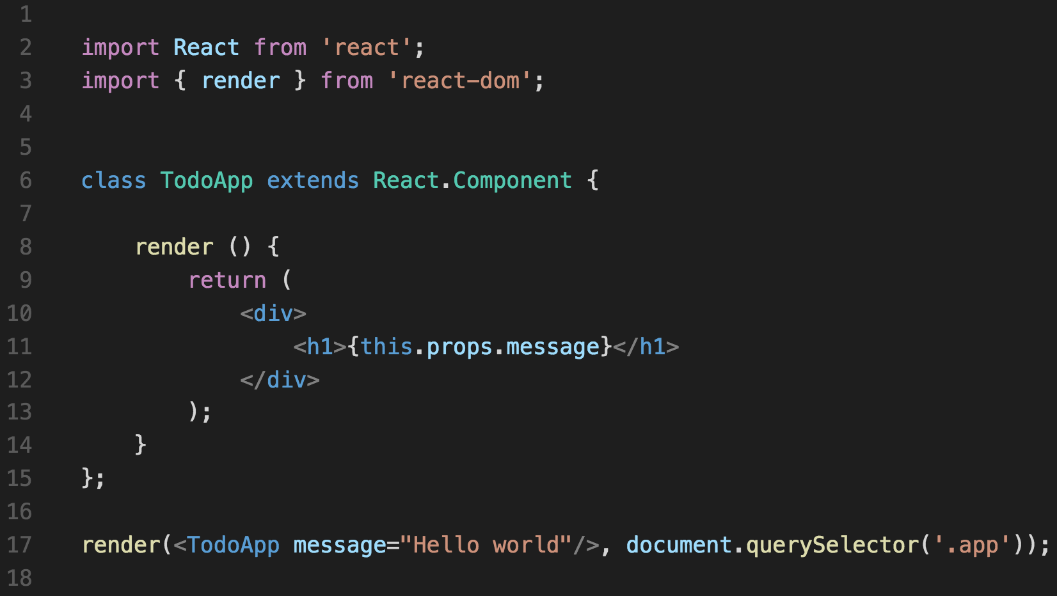
Component props

Slide 12
Component types
Containers (smart Components)
Little or no markup
Pass data and actions down
Presentational (dumb Components)
UI representation focused
Typically functional components

Slide 13
Presentational components
Class Components
have state and lifecycle methods
Functional Components
pure function returning element descriptor
Rule of Thumb – use functional components if no inner state needed
Notes:
The main idea is reusability

Slide 14
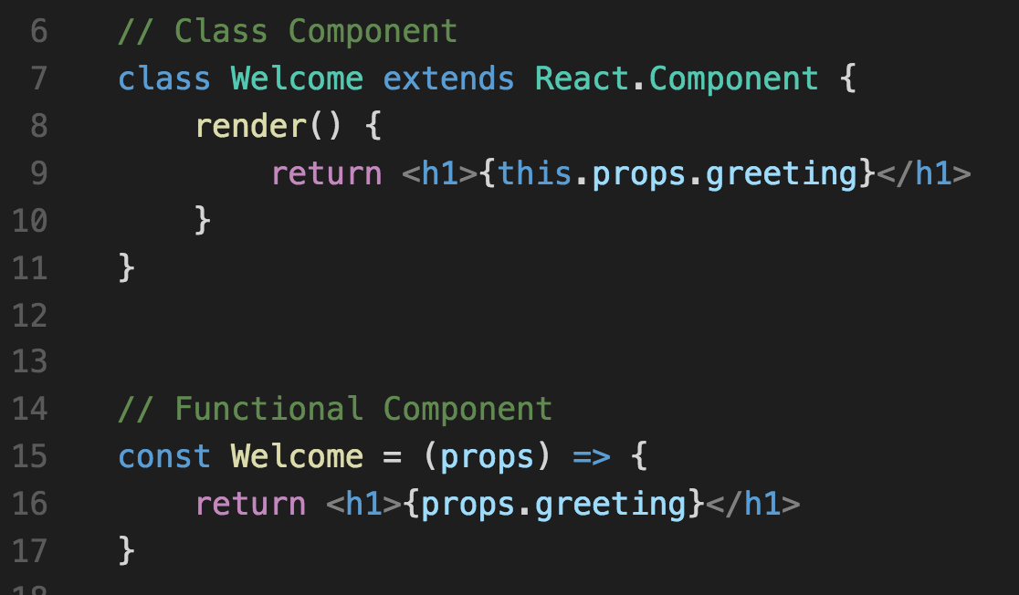
Class vs Functional

Slide 15
Component state
State is used for internal component changes
The state is user-defined, and it should be a plain JavaScript object
The state should not be modified directly, instead use setState()

Slide 16
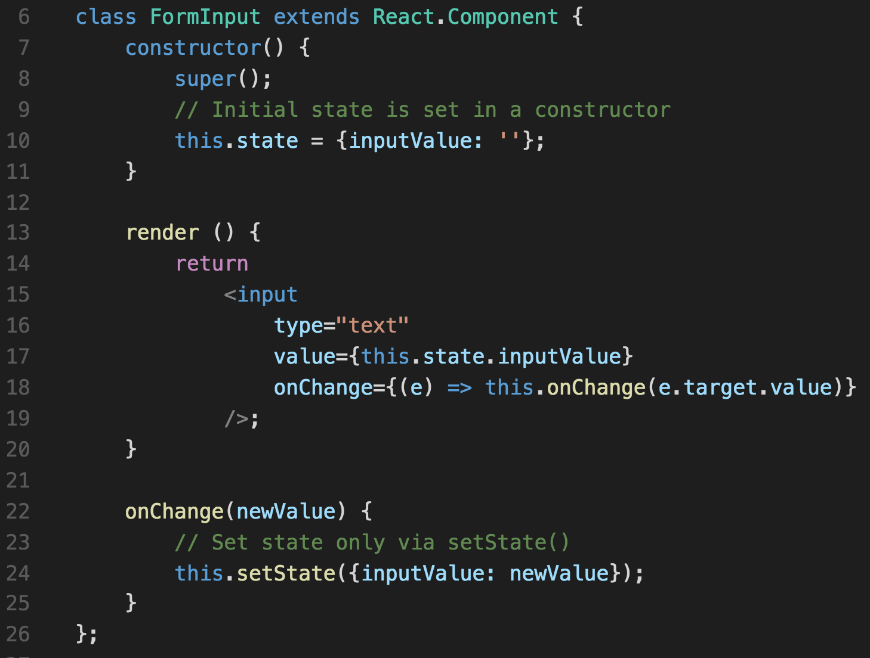
Component state

Slide 17
Component lifecycle
Mounting
constructor()
componentWillMount() – Use constructor instead
render()
componentDidMount() – Fetch data using ajax

Slide 18
Component lifecycle
Updating
componentWillReceiveProps() – only for props
shouldComponentUpdate() – used for optimizations
componentWillUpdate()
render()
componentDidUpdate()

Slide 19
Component lifecycle
Unmounting
componentWillUnmount() – for clearing up the data

Slide 20
Events
Handling events with React elements is very similar to handling events on DOM elements. There are some syntactic differences:
React events are named using camelCase, rather than lowercase.
With JSX you pass a function as the event handler, rather than a string.

Slide 21
Events

Slide 22
Let’s code

Slide 23
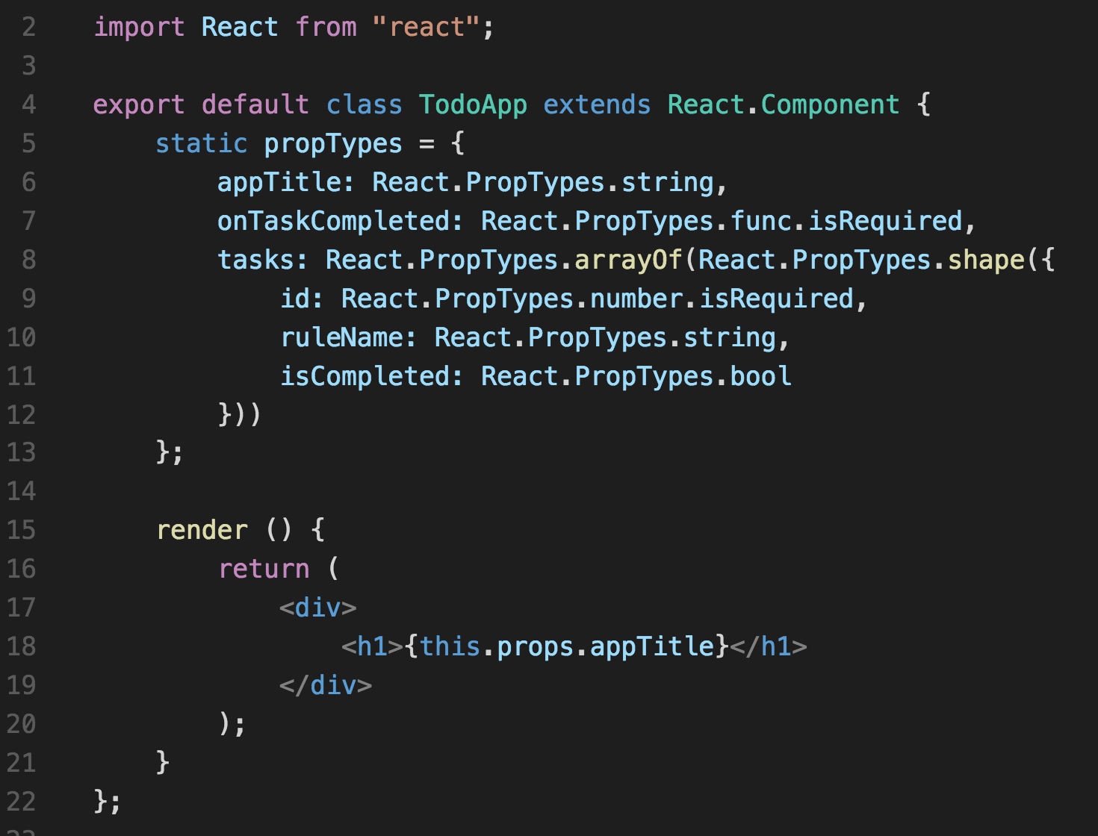
PropTypes

Slide 24
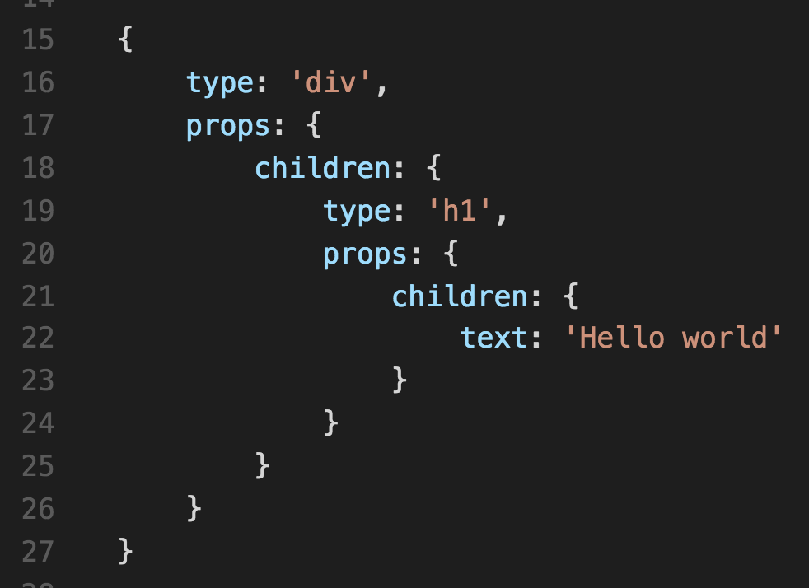
React Element
render() function returns ReactElement
ReactElement is a light, stateless, immutable, virtual representation of a DOM Element.
Notes:
https://medium.com/@dan_abramov/react-components-elements-and-instances-90800811f8ca#.cih3gsbv9

Slide 25
Virtual DOM
In memory representation of the DOM using ReactElements
Cheaper add/remove operations
Together with diff algorithm boosts performance of re-rendering

Slide 26
Diff algorithm
O(n^3) complexity
setState()
Batching

Slide 27
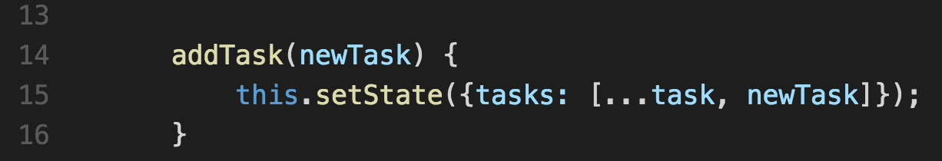
Immutability
Immutable data cannot be changed once created
Can compare objects by reference: this.props.data !=== nextProps.data
Immutable.js lib
Notes:
Intro to spread operator

Slide 28
Best practices
Use containers for data fetching
Use functional components for UI representation
Avoid using component lifecycle methods (componentWillReceiveProps)
Do not use jQuery

Slide 29
Dev tools
https://chrome.google.com/webstore/detail/react-developer-tools

Slide 30
Thank You
www.devbridge.com
Sourcery Academy

